Slide 1

Blockchain Technologies For Supply Chains Project Update
July 29, 2020
This document contains no technical data subject to the EAR or the ITAR.

Slide 2
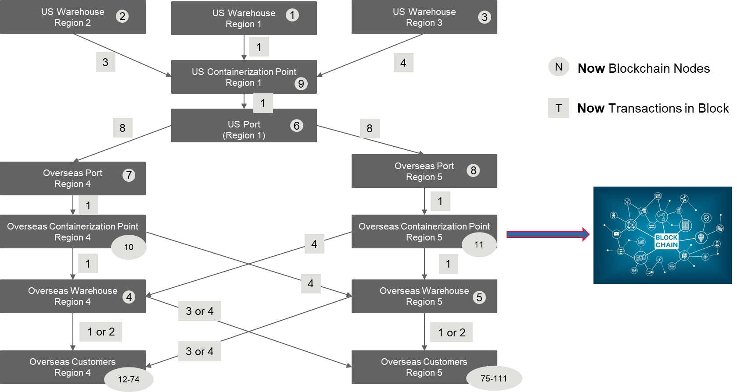
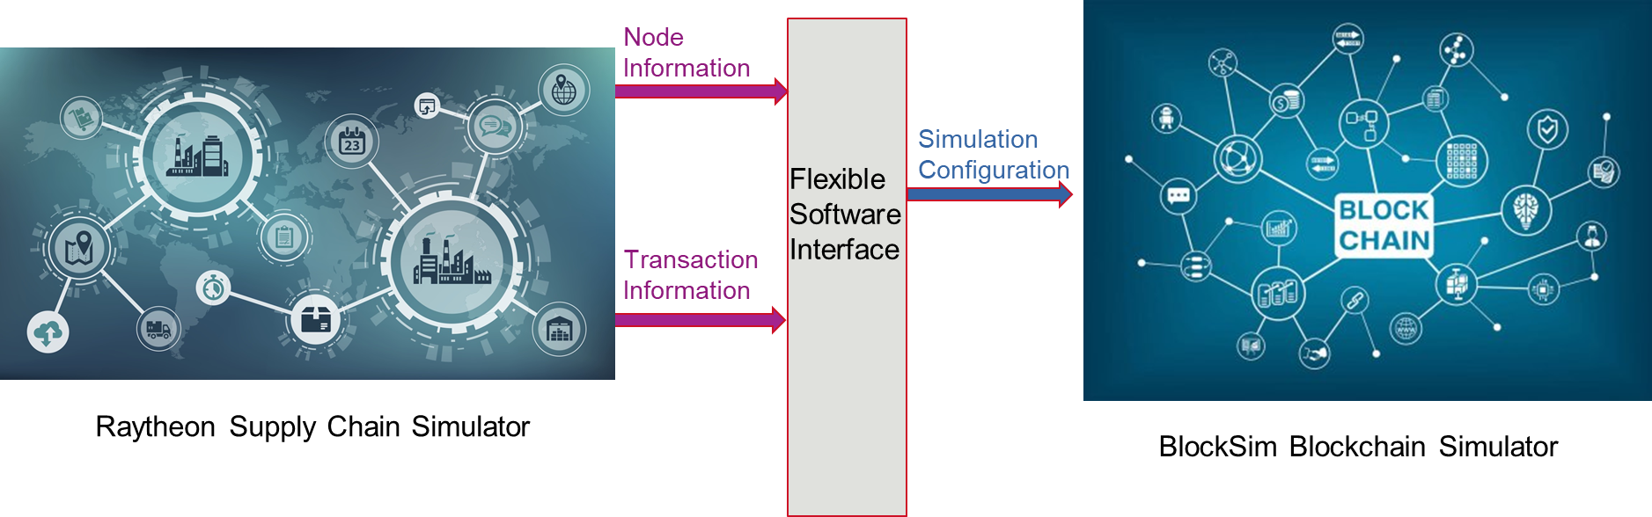
Interfacing Blockchain and Supply Chain Simulators
Reminder: we are using a Blocksim and RTRC coupled framework for analyzing the various protocols and solutions for the DLA
The entities in the RTRC simulator become nodes in the Blockchain
RTX PROPRIETARY – This page does not contain any export controlled technical data.
RTX PROPRIETARY – This page does not contain any export controlled technical data.

Slide 3
Goals and Approach
Summary Goal: Integrate the blockchain simulator with DLA supply chain simulator, to assess different blockchain models’ scalability, security, and interoperability. Develop seamless plug and play software architecture (depicted in previous slide) for rapid integration and flexibility to inform future requirements for a DLA blockchain framework.
Analysis to include multiple parameters of interest: permissioned or permissionless blockchain, Various consensus algorithms (including PoW & PoS), propagation mechanisms, encryption choices, and sharded systems.
Following John Luvera’s guidance, we analyzed multiple blockchain simulation platforms for integration with the RTRC supply chain software and ability to assess performance of existing blockchain solutions on metrics such as permission, security, throughput, scalability and interoperability.
A good choice for simulator significantly reduces potential development time/costs.
RTX PROPRIETARY – This page does not contain any export controlled technical data.

Slide 4
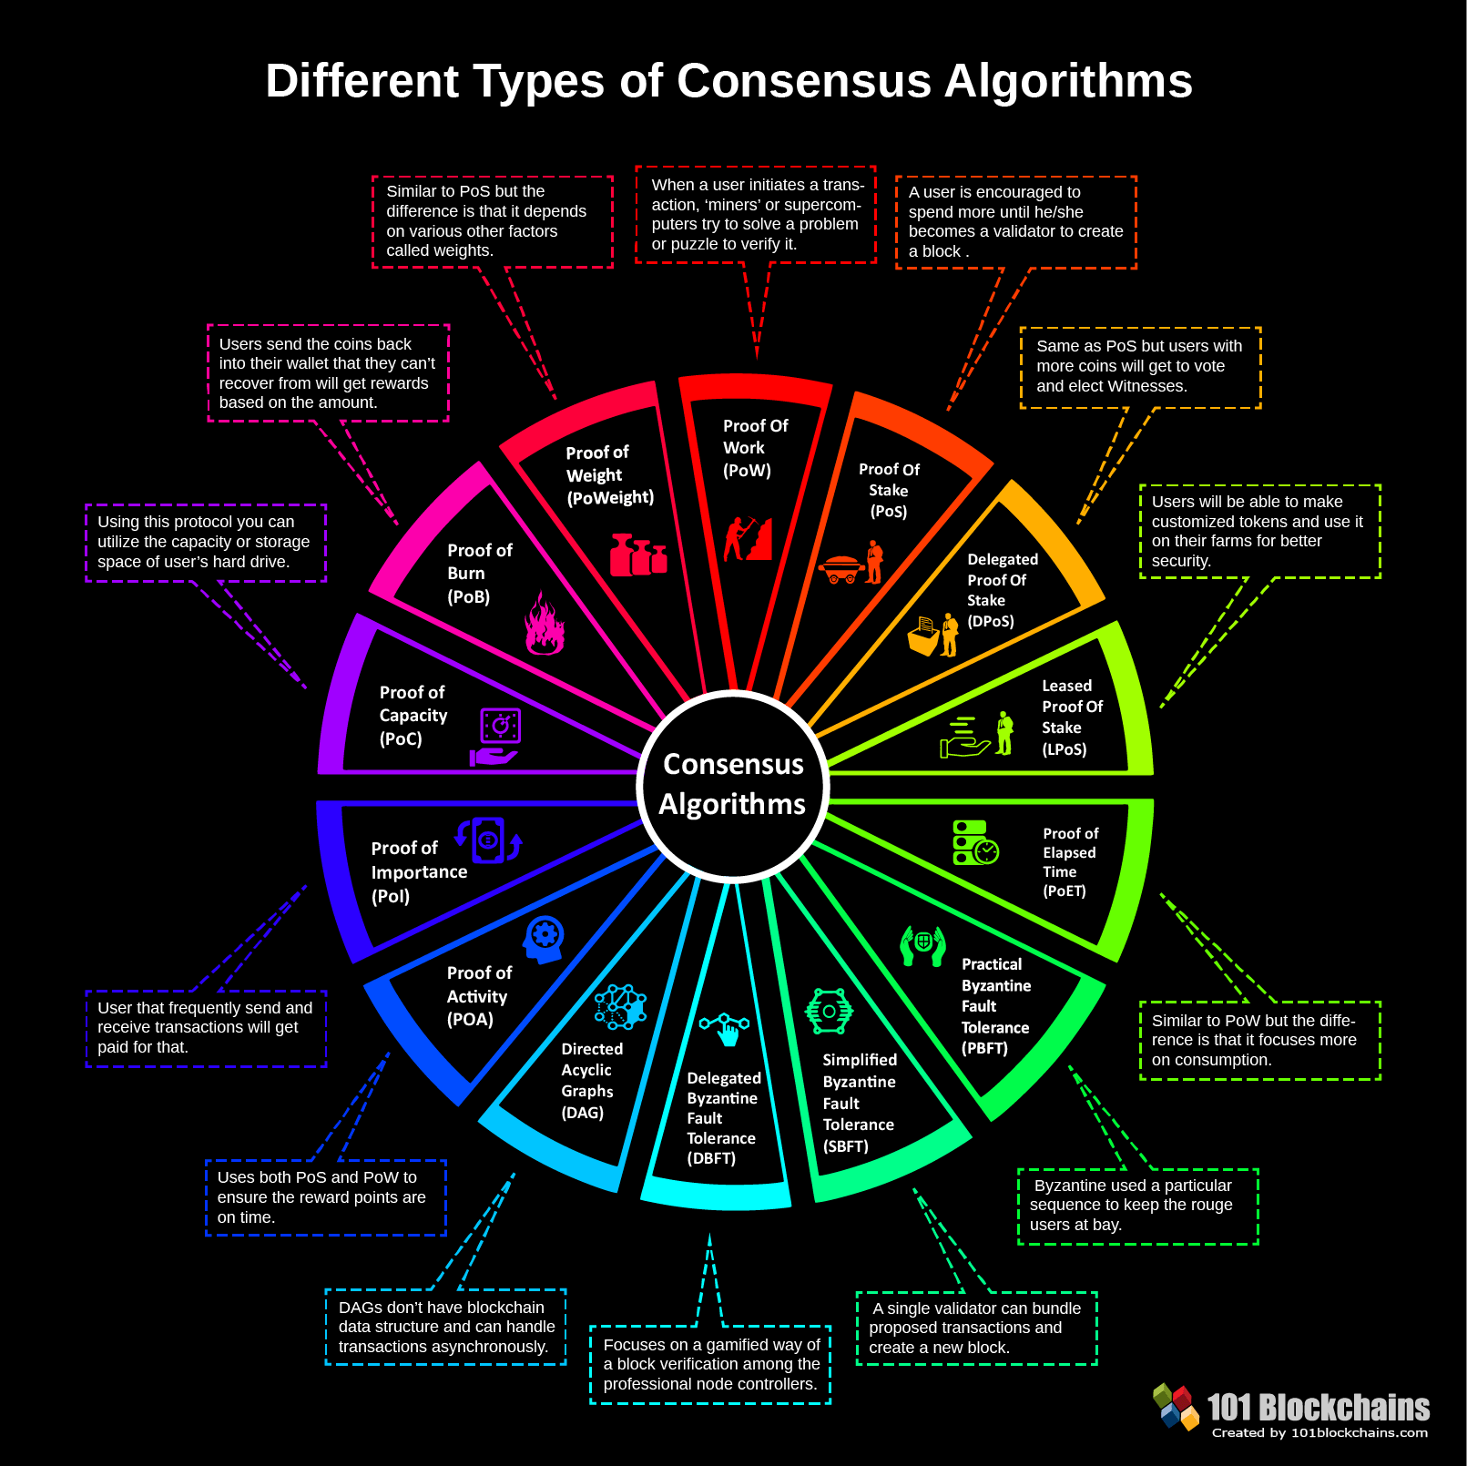
Updates
Step 1: Conceptual Integration of Simulators
Task Complete
Develop integration logic for the two simulators
Define the software interface between the two simulators
Feasibility test with a bridge that pipes information between simulators
Step 2: Preselect Consensus Protocols for Integration
Assess different consensus protocols for integration with the RTRC DLA Supply Chain
Task: 1-2 weeks
Task Complete
RTX PROPRIETARY – This page does not contain any export controlled technical data.

Slide 5
Roadmap for Full Integration
Step 3: Implement Appropriate Consensus Protocols in BlockSim
BlockSim includes two PERMISSIONLESS blockchain models (any entity/node can join the blockchain network)
Blocksim must be modified to support PERMISSIONED blockchains (consensus protocols from step 2)
Task: 2-4 weeks
Task Complete
Step 4: Integration of the Two Simulators
Seamless integration of the Supply chain simulator with Modified Blocksim (step 3)
Once integrated, we will simulate and tradeoff protocols for security, scalability, interoperability and suitability
Fixed Blocksim bug of not splitting transactions into multiple blocks (as they come)
Task: 4-6 weeks
Task Complete
RTX PROPRIETARY – This page does not contain any export controlled technical data.

Slide 6
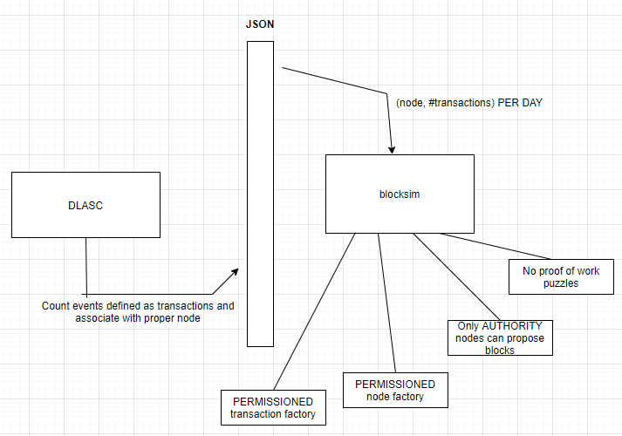
Permissionless vs Permissioned Blockchains
Most cryptocurrencies are examples of blockchains that use permissionless consensus (Bitcoin, Ethereum), but in private networks we want consensus protocols that factor in credentials
As we presented last time, our goal is then to design new permissioned blockchain protocols based on the provided code of Bitcoin and Ethereum.
We preselected two appropriate, popular and powerful protocols: Proof of Authority (PoA) and Practical Byzantine Fault Tolerance (PBFT)
RTX PROPRIETARY – This page does not contain any export controlled technical data.

Slide 7
PoA and PBFT vs. Existing Permissioned Blockchains
Why PoA and PBFT over other? Because these two are the two popular representatives of permissioned blockchain:
1. They are both Byzantine fault tolerant.
2. They are easier to develop, consecutively.
3. They have different flavor and properties. “The conducted analysis results that PoA algorithms favour availability over consistency, oppositely to what PBFT guarantees.”
“In permissioned blockchain settings, dominant candidates are Byzantine fault tolerant (BFT) algorithms such as the PoA and PBFT.”
“Proof-of-Authority (PoA) is a new family of BFT algorithms which has recently drawn attention due to the offered performance and toleration to faults…... Differently from PBFT, PoA requires less message exchanges hence provides better performance” [De Angelis, Stefano, et al., 2018]
RTX PROPRIETARY – This page does not contain any export controlled technical data.

Slide 8
PoA vs. PBFT
PoA:
Pros
Provides higher speed
Simpler to understand
A good way to demo permissioned blockchain functionality
Cons
Does not fully guarantee data integrity
Incomplete theoretical analysis
PBFT:
Pros
Makes strong data consistency guarantees
Strong theoretical proof
Cons
Performance does not scale well to large number of nodes
Conclusion:
We would recommand both PoA and PBFT, one optimized for performance and the other optimized for consistency.
RTX PROPRIETARY – This page does not contain any export controlled technical data.

Slide 9
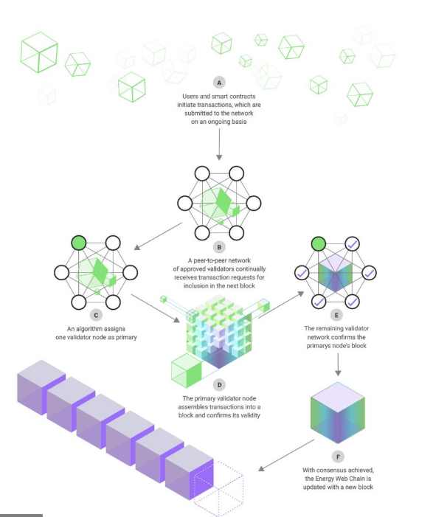
Protocol 1: Proof of Authority (PoA)
Integrate Proof of Authority with the Blocksim framework (currently only supports PoW and PoS)
Based on the existing Bitcoin and Ethereum protocols in BlockSim, we have successfully built a new and efficient permissioned blockchain model, which is adapted from a real-world proof-of-authority protocol, namely Clique.
Only a small, trusted group of authorities are permitted to propose Blocks
All authority members propose blocks in turn and broadcast to all nodes, exclusively. No Proof of Work step (has to be removed
from Blocksim)
RTX PROPRIETARY – This page does not contain any export controlled technical data.

Slide 10
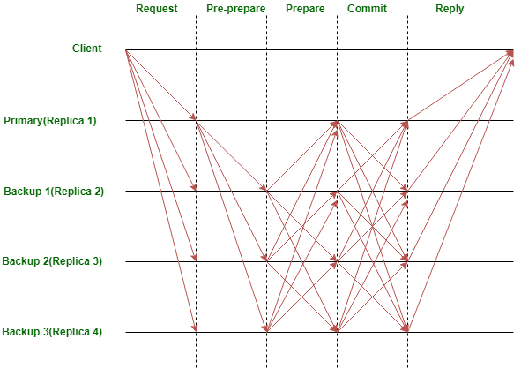
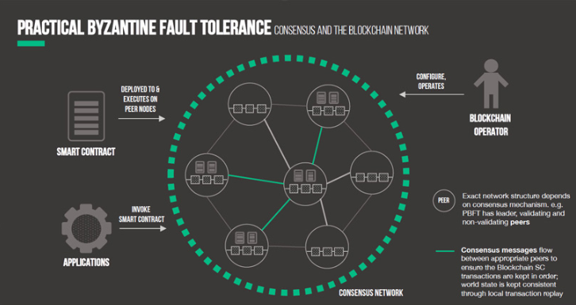
Protocol 2: Practical Byzantine Fault Tolerance (PBFT)
Integrate Practical Byzantine Fault Tolerance (PBFT) with Blocksim
Byzantine Faults correspond to misinformation/inconsistencies in the network data.
PoA makes performance improvements (faster) at the cost of consistency guarantees that PBFT offers
At the core of PBFT is a information replication step for asynchronous settings
RTX PROPRIETARY – This page does not contain any export controlled technical data.

Slide 11
Protocol 2: Practical Byzantine Fault Tolerance (PBFT)
Guarantees liveness (system will not stall due to errors) and safety (system will converge to the correct decisions even with errors) as long as less than 1/3 fraction of nodes are malicious
Steps
1. client requests an operation from an
authority node
2. authority node broadcasts the request to
the other authority nodes
3. Authority nodes carry out three phases to ensure
consistency among operations that all replicas will carry out (“pre-prepare”, “prepare”, “commit”)
RTX PROPRIETARY – This page does not contain any export controlled technical data.

Slide 12
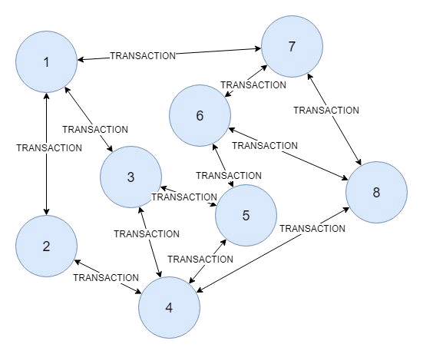
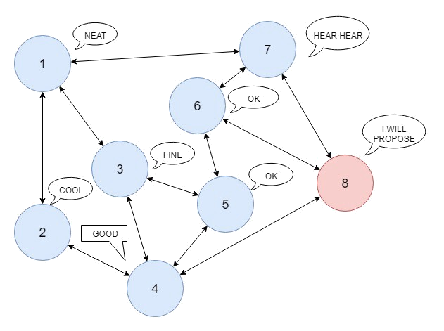
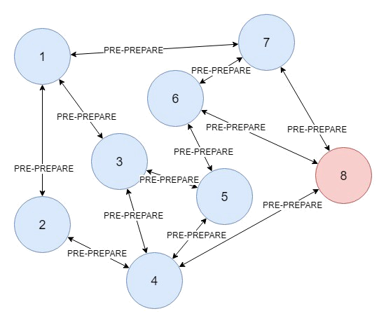
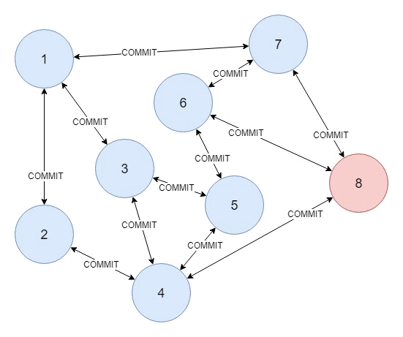
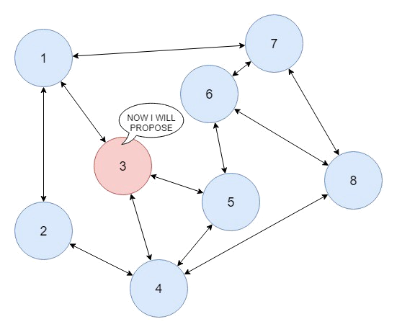
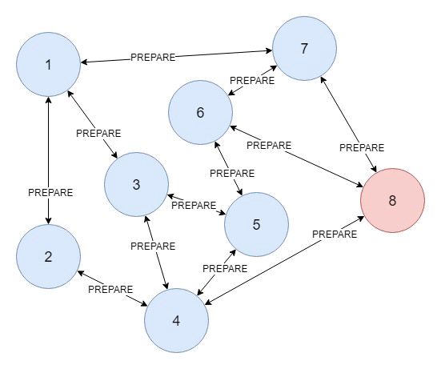
Protocol 2: Practical Byzantine Fault Tolerance (PBFT)
Message contains block
2f+1 messages needed
Message implies agreement
2f+1 messages needed
RTX PROPRIETARY – This page does not contain any export controlled technical data.
Message implies agreement.
2f+1 needed by a node

Slide 13
Protocol 2: Practical Byzantine Fault Tolerance (PBFT)
Under normal operation, an authority node is called a “leader”
The leader’s reign is called a “view”
We move on to the next view when a leader is perceived to be faulty by the other authorities
Current Implementation within Blocksim
All phases implemented
RTRC simulator modified to generate arbitrary number of orders
Only single view (no malicious nodes)
RTX PROPRIETARY – This page does not contain any export controlled technical data.

Slide 14
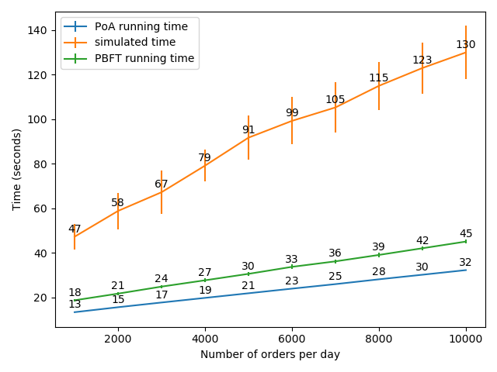
Results of PoA and PBFT in Blocksim
Analyze time and memory usage for the DLA use case – different size orders
Running time and simulated time increase linearly with number of orders
Matches theoretical analysis
PoA vs PBFT
- PoA has lower computational and memory cost
- PBFT has guaranteed consistency
RTX PROPRIETARY – This page does not contain any export controlled technical data.

Slide 15
Upcoming Tasks
Step 1: Implement View Changes with PBFT
Use view changes to model malicious nodes
Analyze degradation of performance with increasing number of compromised nodes
Task: 4 weeks
Step 2: Check Implementations for Correctness
Parallel with Step 1, ensure our parameters and implementations match current best practices in Blockchain Industry and state-of-the-art implementations
Task: 4 weeks
Step 3: Advanced Models for Malicious Nodes
Integration of different models of malicious behavior
Inclusion of game theoretic framework
Task: 6 weeks
RTX PROPRIETARY – This page does not contain any export controlled technical data.

Slide 16
Upcoming Tasks
Step 4: Hyperledger Use for Realistic Modeling
Build accurate consensus models within Hyperledger
Simulate small instance to improve simulator realism using procured statistics
Task: 6 weeks
Step 5: Counterfeit Part Tracking
Tokenize parts in the supply chain: hardware solutions overview (such as Diamond Unclonable Security Tags)
Integrate Blockchains with serial number verification
Certificate Authority integration
Use RTRC work on bottleneck identification to pinpoint injection of counterfeit parts
Investigate composable serial numbers for systems
Task: 8 weeks
RTX PROPRIETARY – This page does not contain any export controlled technical data.

Slide 17
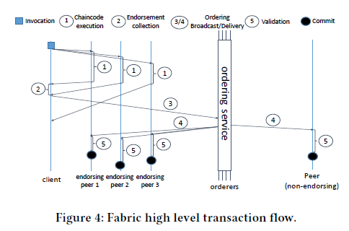
Hyperledger Task Details
Hyperledger is the primary mode of actual blockchain deployment
Hyperledger Fabric is a “distributed Operating System” that supports permissioned blockchain networks
It supports “modular consensus”, right now it supports different forms of consensus including Raft and PBFT, and theoretically custom consensus protocols
By writing “chaincode” in high level programming languages, arbitrary smart contracts can be programmed (any application can be implemented using the Hyperledger framework)
Hyperledger is a use case for permissioned blockchain applications, gather data that quantifies how Hyperledger works in practice: integrate with simulator
RTX PROPRIETARY – This page does not contain any export controlled technical data.

Slide 18
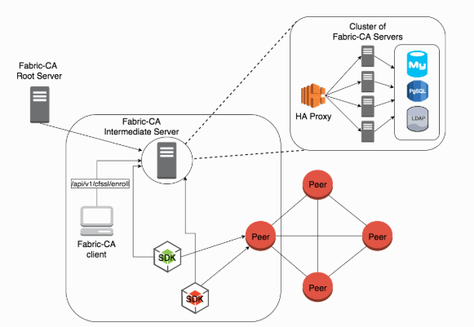
Hyperledger Certificate Authority
Hyperledger has a built in Fabric Certificate Authority
Each organization involved in the Hyperledger blockchain can run their own root and intermediate CA servers
The servers register an “admin” as well as the different peers
It provides options for X.509 certificates based on state of the art cryptography (ECDSA, RSA)
Use for parts verification for serial numbers
RTX PROPRIETARY – This page does not contain any export controlled technical data.

Slide 19
Backup

Slide 20
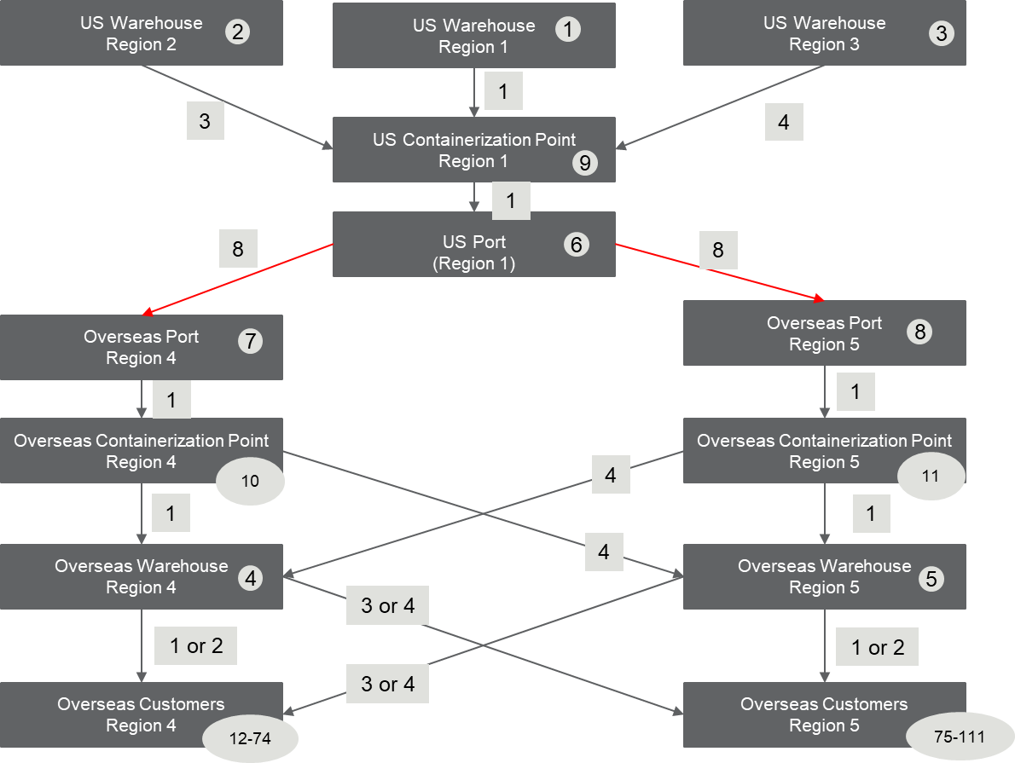
Interoperability Considerations
Integration of DLA supply chains with 3rd party solutions (shipping companies and suppliers)
Interoperability is essential for maximizing information gathering and intelligence.
Design Options for Interoperability:
Open Protocols
Multi-Chain Frameworks
RTX PROPRIETARY – This page does not contain any export controlled technical data.

Slide 21
Parts Tracking and Counterfeit Detection
Use RTRC simulator to identify vulnerable locations in supply chain
Couple the information in two simulators (orders and actual transactions) to identify potential injection of counterfeit parts
Explore blockchain integration with hardware solutions:
- Diamond Unclonable Security Tag (DUST) - uses nanodiamonds to create unique identifiers that can be embedded into physical object in order to verify its authenticity connect it to a blockchain.
- Tangem Microchips - microchip that can be embedded into physical objects to provide better tracking, verify authenticity, and connect to a blockchain. Provides Near-Field-Communication and is compatible with smart devices.
1
RTX PROPRIETARY – This page does not contain any export controlled technical data.

Slide 22
Open Protocols Vs. Multichain Frameworks
1. Open Protocols
Atomic Cross-Chain Swap: allows for the exchange of tokens running on distinct blockchains through smart contracts
Lightning Networks: “off-chain” or “layer two” payment system that allows two users to transact without the payments being directly recorded onto the blockchain
Communicates with the blockchain periodically
Faster transaction speeds and greater/bounded liquidity
2. Multichain Frameworks
Examples are Cosmos and and Polkadot
Establishment of multiple sub-blockchains that are reinforced by a final ‘Settlement Layer’ that is incorruptible, always available, resilient, and can serve as final arbitrator
Sub-chains interact with settlement layer/final blockchain, they must still exist within the same ecosystem
RTX PROPRIETARY – This page does not contain any export controlled technical data.

Slide 23
PoA and PBFT vs. Existing Permissioned Blockchains
Why PoA and PBFT over other? Because these two are the two popular representatives of permissioned blockchain:
1. They are both Byzantine fault tolerant.
2. They are easier to develop, consecutively.
3. They have different flavor and properties. “The conducted analysis results that PoA algorithms favour availability over consistency, oppositely to what PBFT guarantees.”
“In permissioned blockchain settings, dominant candidates are Byzantine fault tolerant (BFT) algorithms such as the PoA and PBFT.”
“Proof-of-Authority (PoA) is a new family of BFT algorithms which has recently drawn attention due to the offered performance and toleration to faults…... Differently from PBFT, PoA requires less message exchanges hence provides better performance” [De Angelis, Stefano, et al., 2018]
RTX PROPRIETARY – This page does not contain any export controlled technical data.

